Slide 1
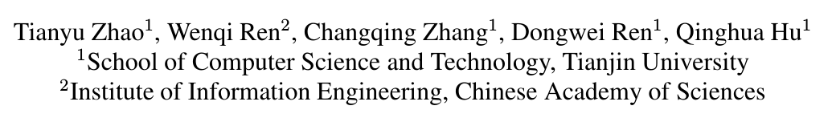
Unsupervised Degradation Learning for Single Image Super-Resolution

Slide 2
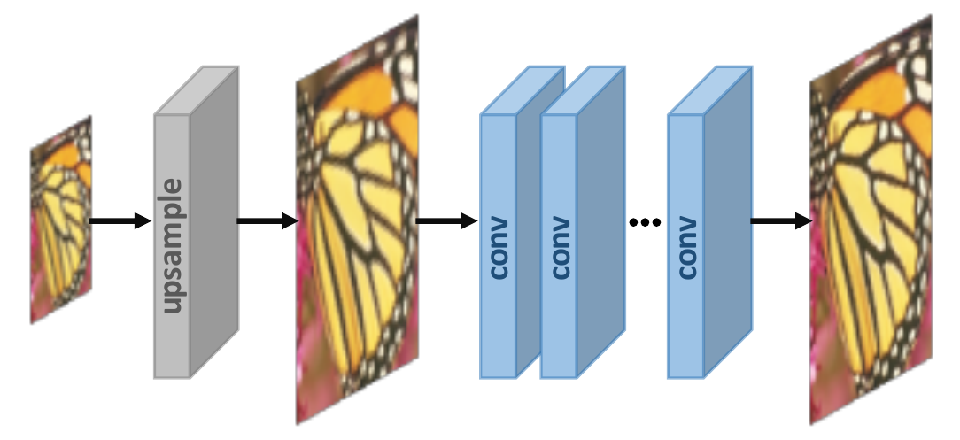
Motivation:
The degradation is always artificially designed, such as Bicubic downsampling, Gaussian downsampling, etc.
For real-world cases, the degradation from HR to LR may be more complex (blur, compression, noise, etc).
Propose
A real-world LR image guided bi-cycle network for SISR.

Slide 3
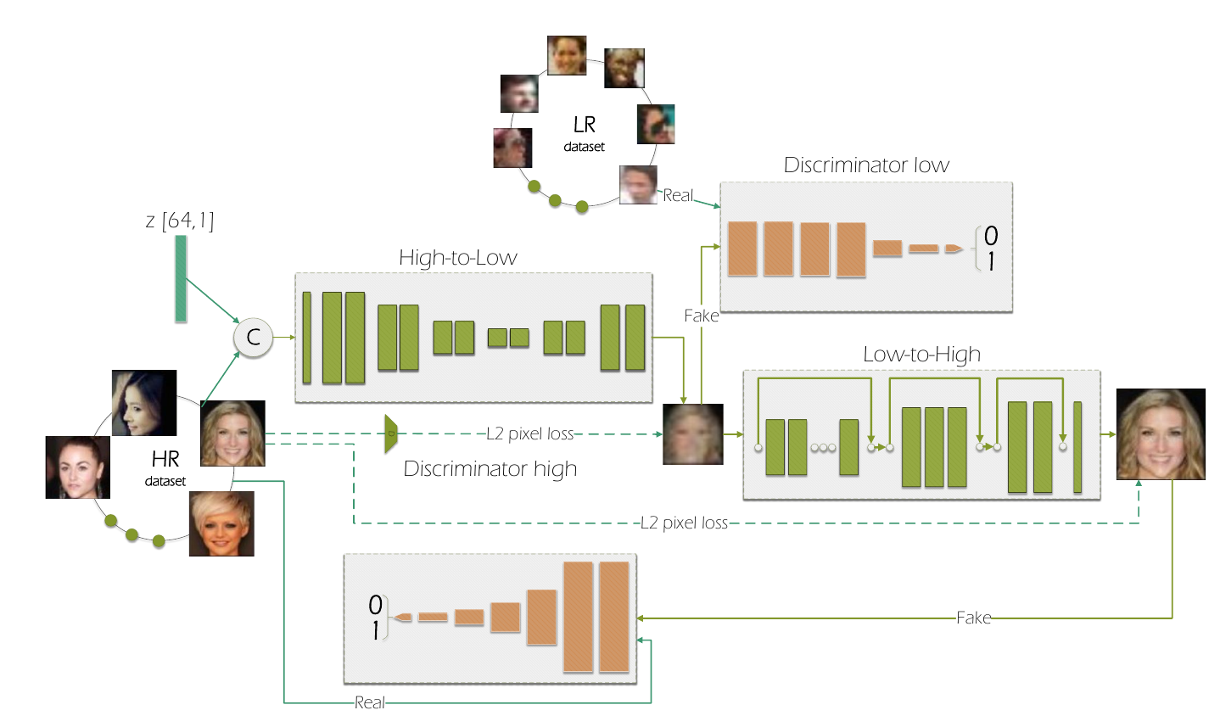
Previous work: (ECCV 2018)
High-to-Low: unpair
Low-to-High: pair
To learn image super resolution, use a GAN to learn how to do image degradation first. (ECCV 2018)

Slide 4
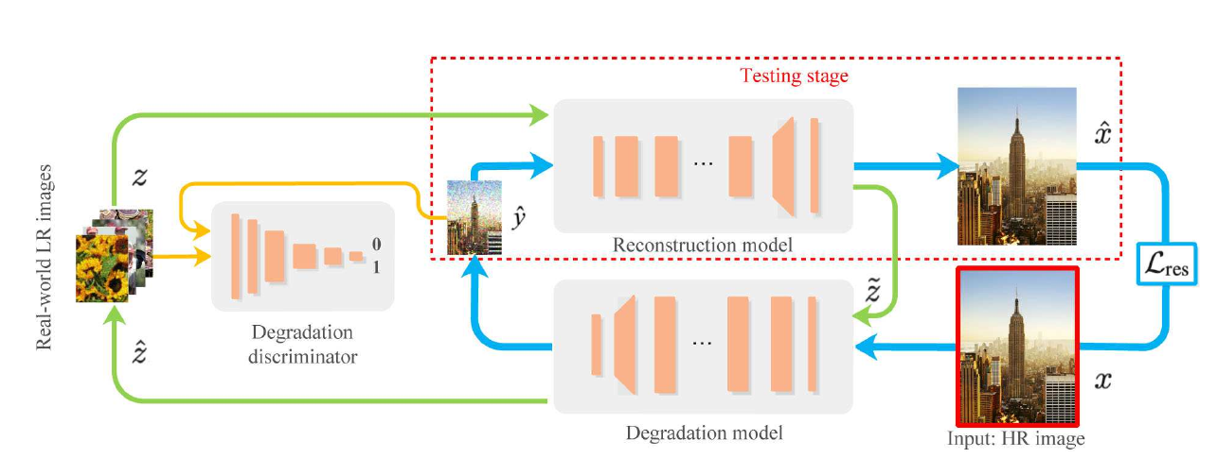

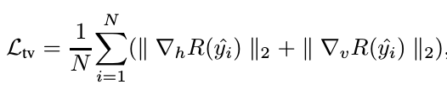

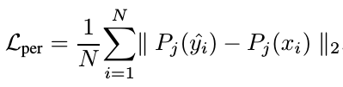

Framework (totally unpair):
(With GAN loss only, it's hard to preserve the structure similairty.)

Slide 5
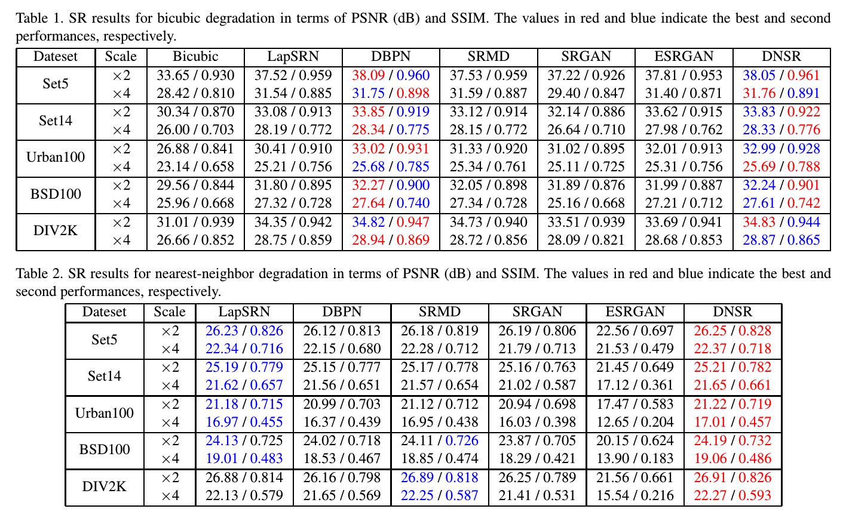
Performance:

Slide 6
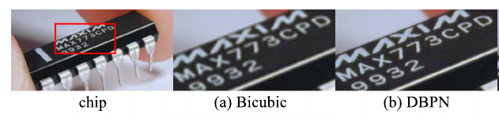
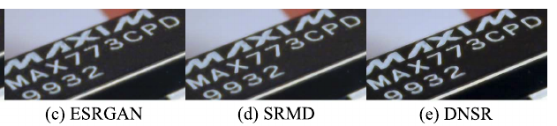
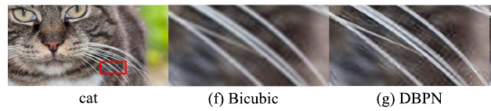
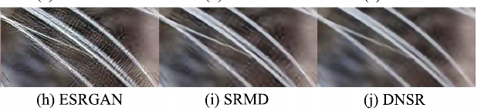
Performance:

